Slide 1



Actual Vs Budget
View in Power BI
Last data refresh:
5/2/2022 3:53:36 AM UTC
Downloaded at:
5/2/2022 10:59:15 AM UTC

Slide 2
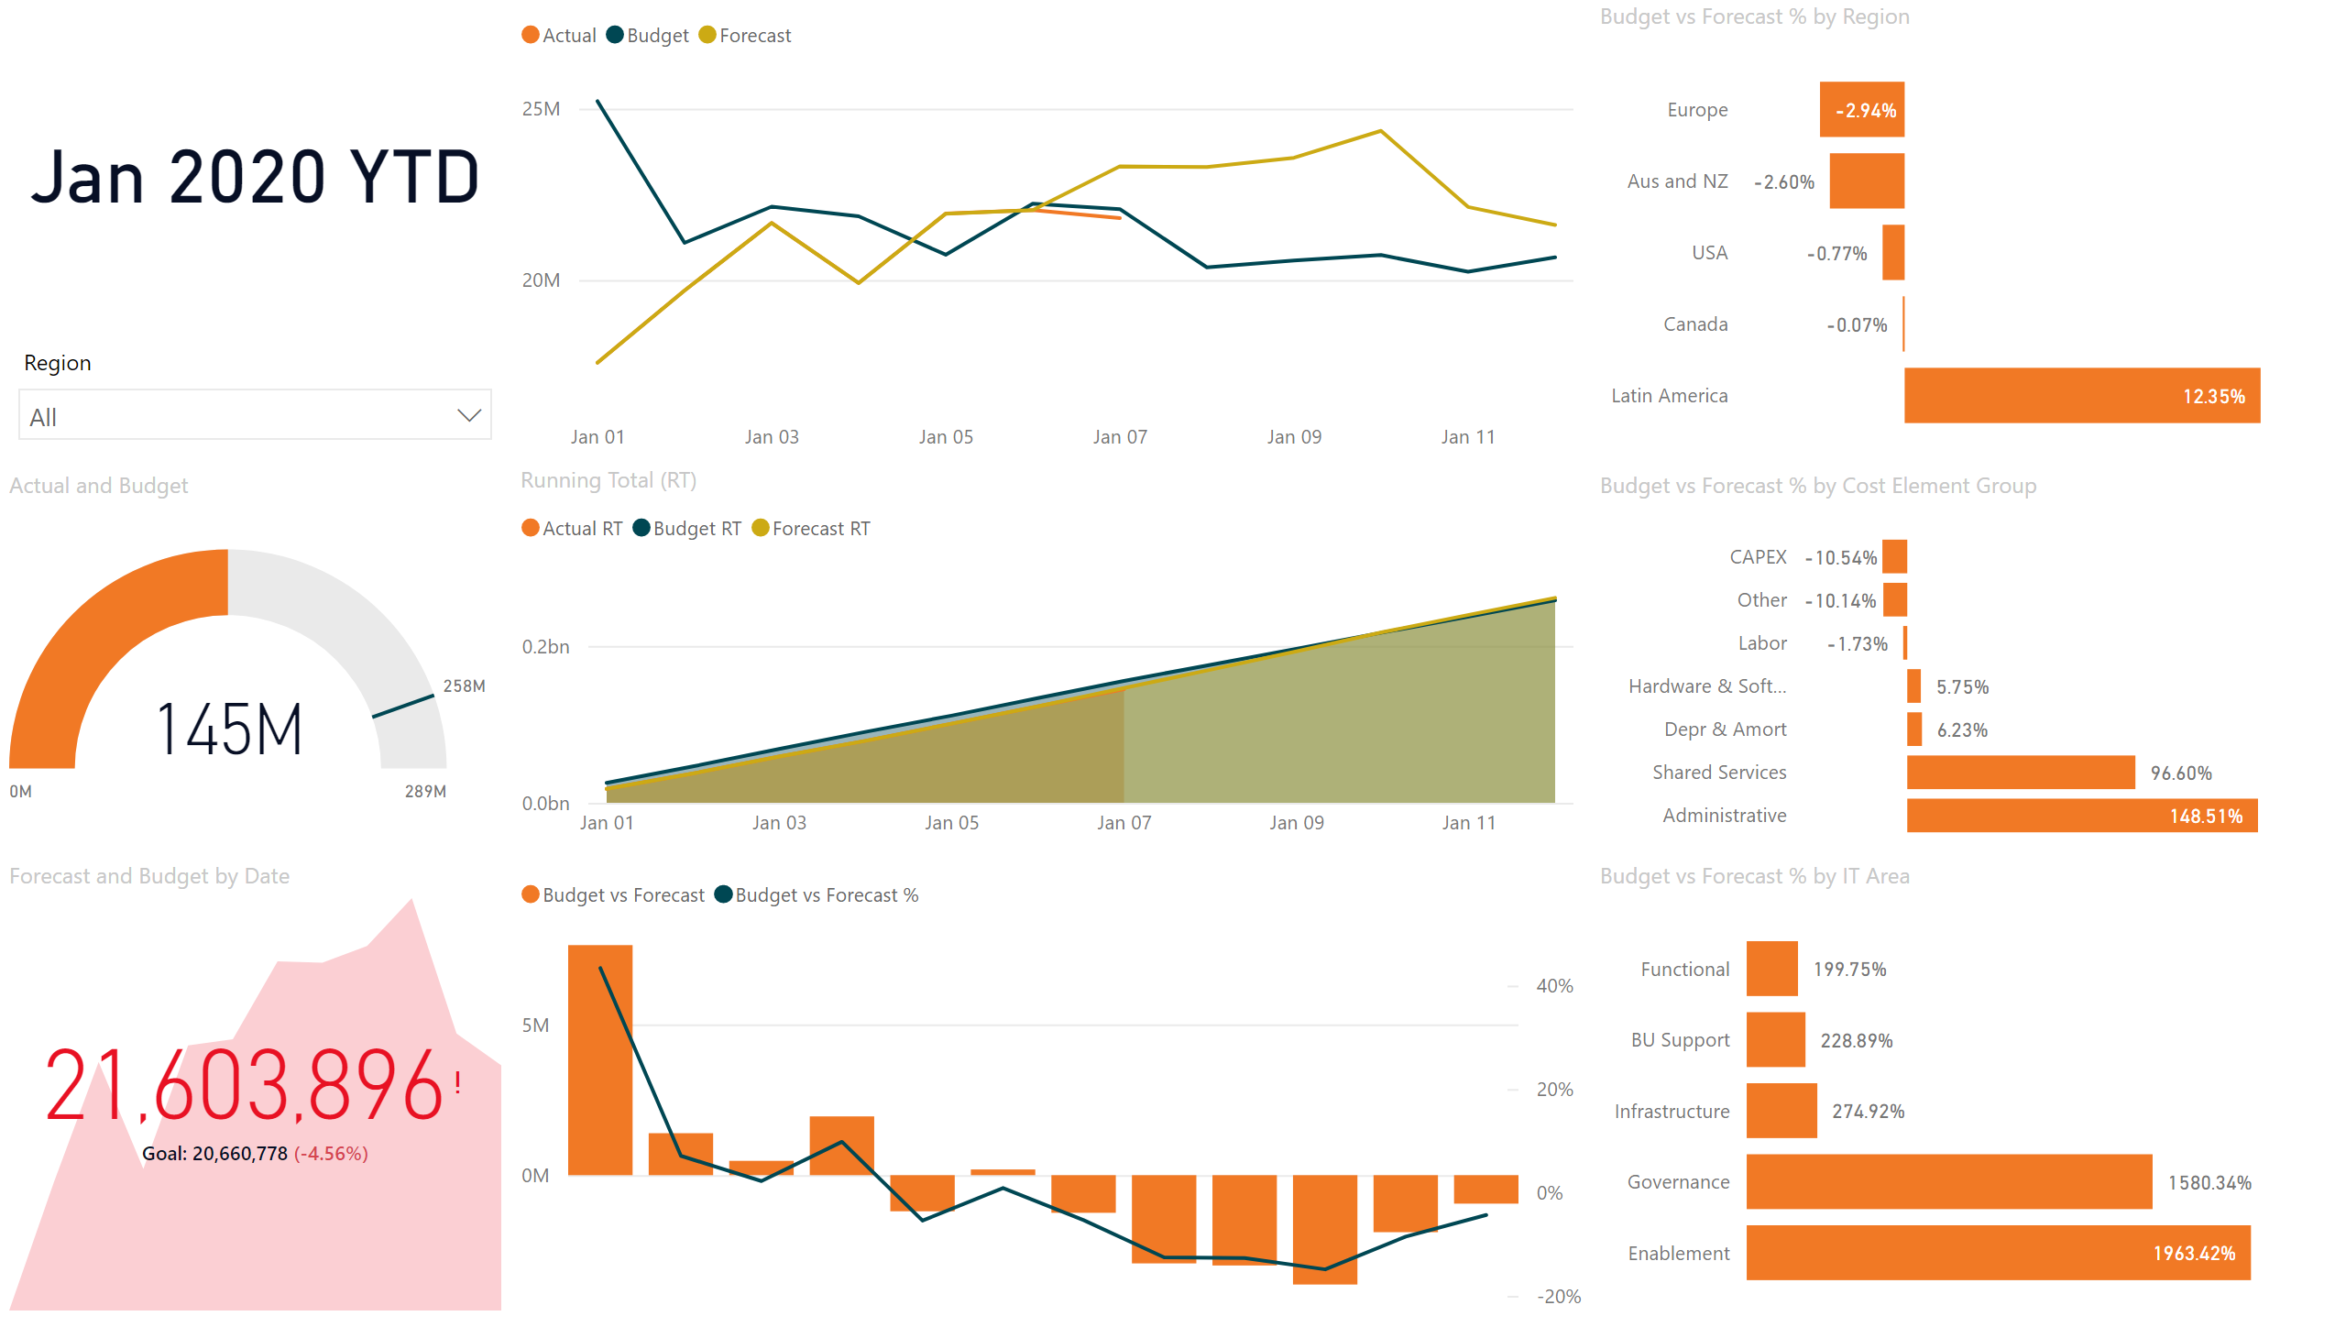
Headline
Notes:
gauge
No alt text provided
kpi
No alt text provided
lineStackedColumnComboChart
No alt text provided
clusteredBarChart
No alt text provided
lineChart
No alt text provided
Running Total (RT)
No alt text provided
slicer
No alt text provided
clusteredBarChart
No alt text provided
clusteredBarChart
No alt text provided
card
No alt text provided

Slide 3
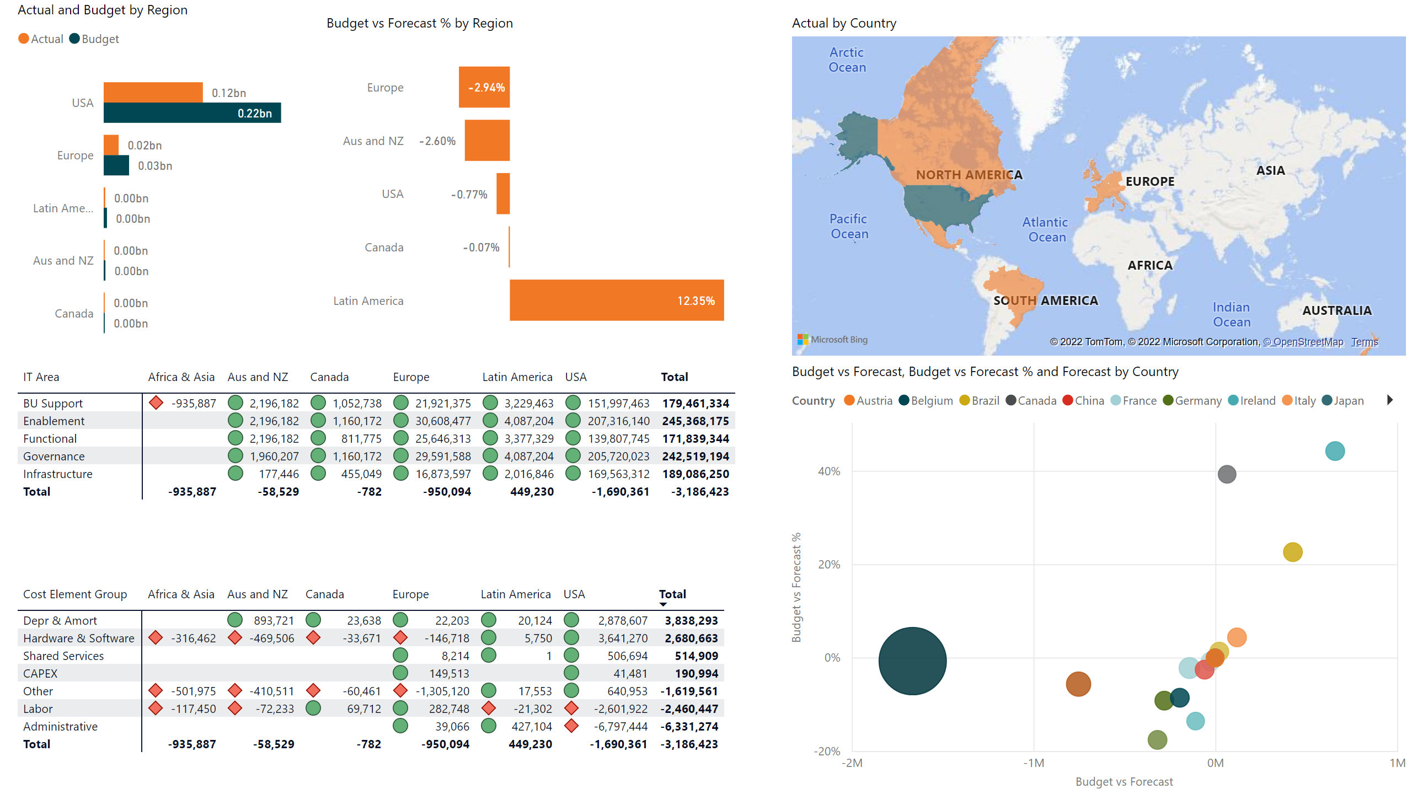
Regions
Notes:
clusteredBarChart
No alt text provided
clusteredBarChart
No alt text provided
pivotTable
No alt text provided
pivotTable
No alt text provided
filledMap
No alt text provided
scatterChart
No alt text provided

Slide 4
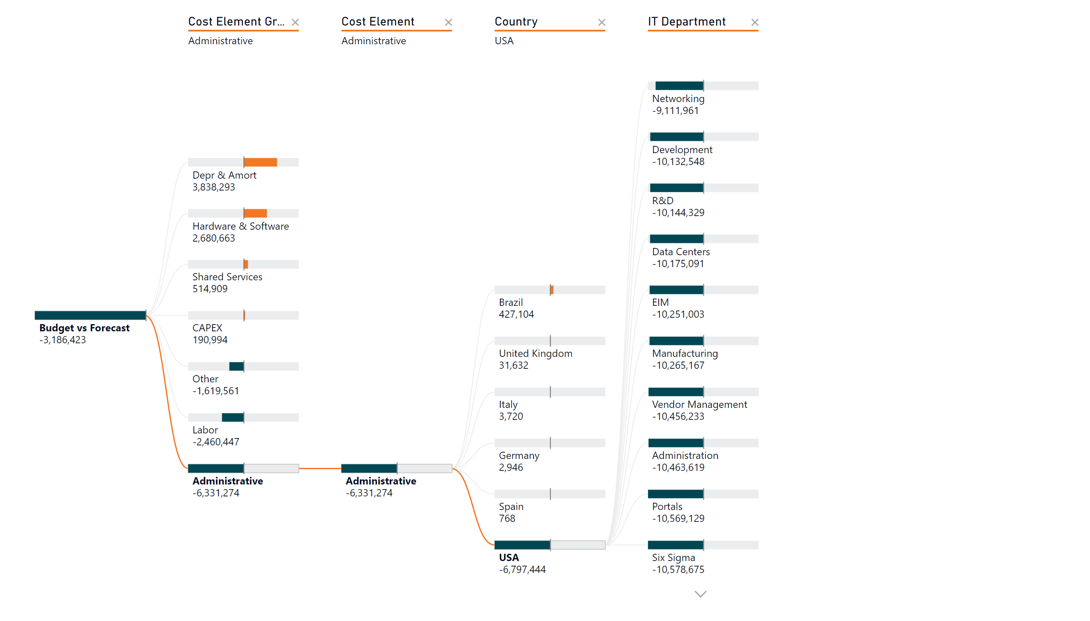
Decomposition
Notes:
decompositionTreeVisual
No alt text provided

